Slide 1
Foundations of Cryptography sEUF-CMA, IND-CCA, hash function, second-preimage resistance, preimage resistance
LiangFeng Zhang
zhanglf@shanghaitech.edu.cn
SIST, ShanghaiTech, 2019F

Slide 2


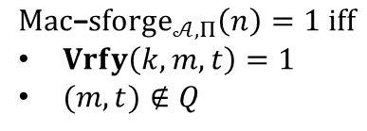





sEUF-CMA
The Strong Message Authentication Experiment: $Mac$-$sforge_{𝒜,Π}(n)$
$$k←Gen\left(1^{n}\right)$$
$$orace access to$$
$$Mac(k,⋅)$$
$$Challenger$$
$$Adversary 𝒜$$
$$(m,t)$$
$$Mac\text{−}sforge_{𝒜,Π}\left(n\right)=1 iff$$
$Vrfy\left(k,m,t\right)=1$
$(m,t)∉Q$
$Q:$ the set of (message, tag) pairs queried by $𝒜$

Slide 3
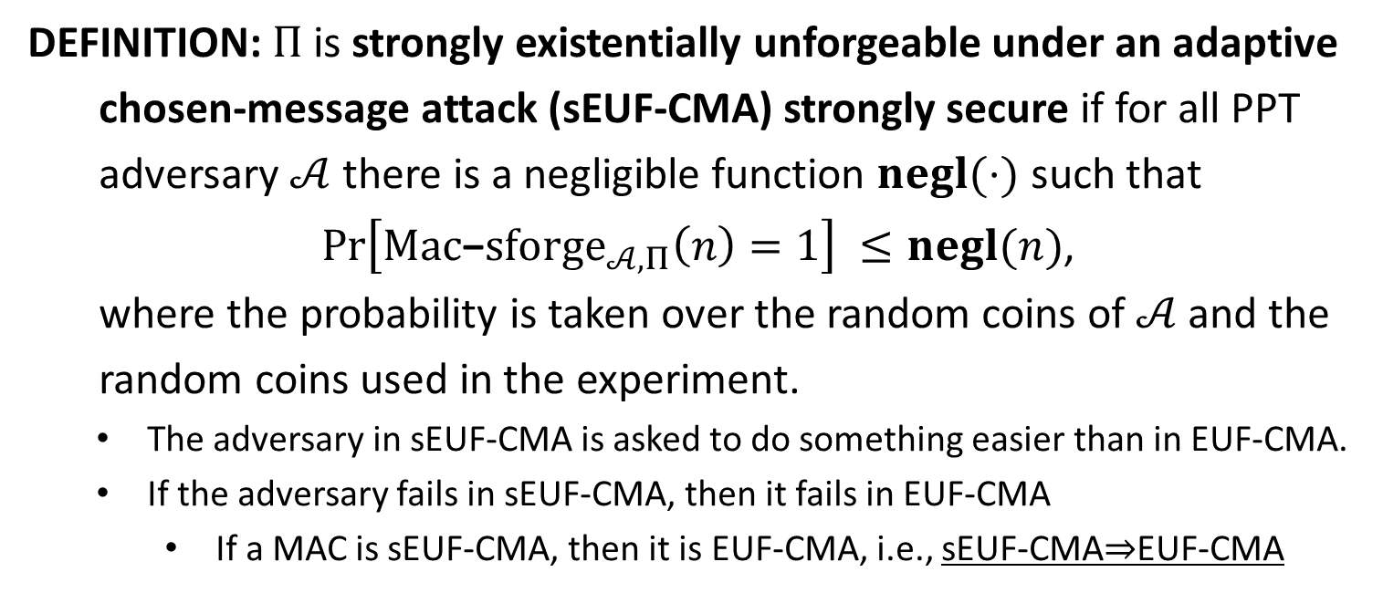
sEUF-CMA
DEFINITION: $Π$is strongly existentially unforgeable under an adaptive
chosen-message attack (sEUF-CMA) strongly secure if for all PPT
adversary $𝒜$ there is a negligible function $negl(⋅)$ such that
$\operatorname{Pr}\left[Mac\text{−}sforge_{𝒜,Π}\left(n\right)=1\right] ≤negl(n)$,
where the probability is taken over the random coins of $𝒜$ and the
random coins used in the experiment.
The adversary in sEUF-CMA is asked to do something easier than in EUF-CMA.
If the adversary fails in sEUF-CMA, then it fails in EUF-CMA
If a MAC is sEUF-CMA, then it is EUF-CMA, i.e., sEUF-CMA$⇒$EUF-CMA

Slide 4

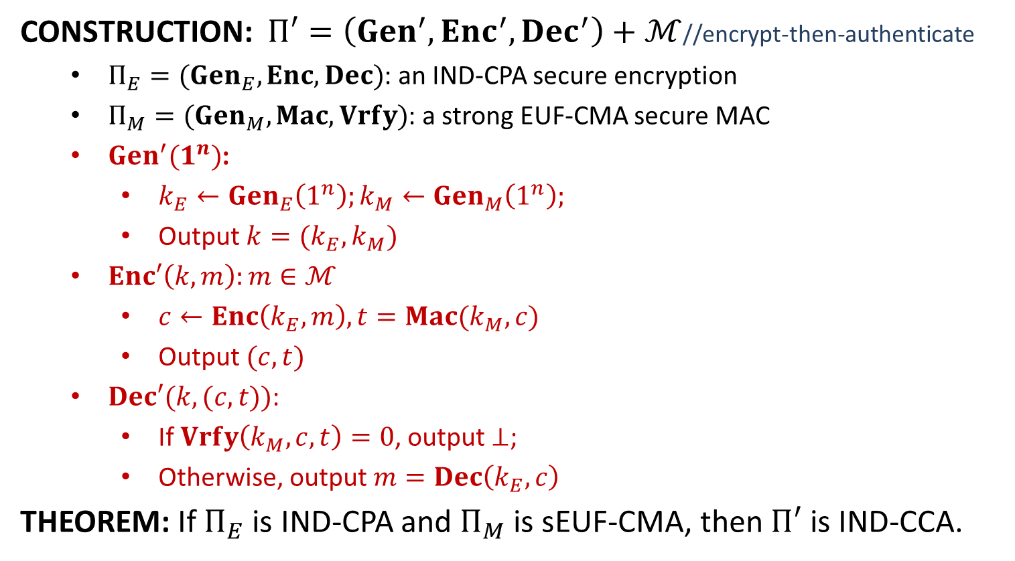
IND-CPA+sEUF-CMA$⇒$ IND-CCA
CONSTRUCTION: $Π′=\left(Gen^{′}, Enc^{′}, Dec^{′}\right)+ℳ$//encrypt-then-authenticate
$Π_{E}=(Gen_{E}, Enc, Dec)$: an IND-CPA secure encryption
$Π_{M}=(Gen_{M}, Mac, Vrfy)$: a strong EUF-CMA secure MAC
$Gen^{′}(1^{n})$:
$k_{E}←Gen_{E}\left(1^{n}\right);k_{M}←Gen_{M}\left(1^{n}\right);$
Output $k=(k_{E},k_{M})$
$Enc′\left(k,m\right):m∈ℳ$
$c←Enc\left(k_{E},m\right), t=Mac(k_{M},c)$
Output $(c,t)$
$Dec′(k,(c,t))$:
If $Vrfy\left(k_{M}, c,t\right)=0$, output $⊥$;
Otherwise, output $m=Dec\left(k_{E},c\right)$
THEOREM: If $Π_{E}$ is IND-CPA and $Π_{M}$ is sEUF-CMA, then $Π′$ is IND-CCA.

Slide 5
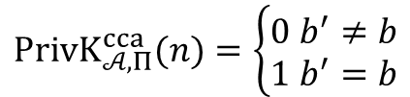




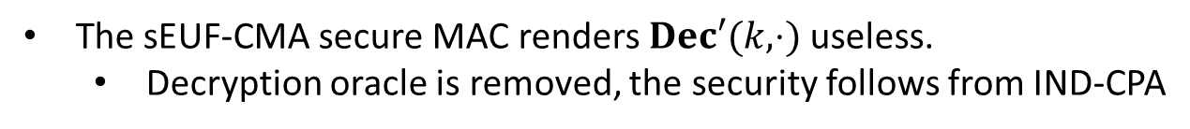









Security
$$k←Gen′\left(1^{n}\right)$$
$$oracle access to$$
$$Enc′\left(k,⋅\right), Dec′(k,⋅)$$
$$m_{0},m_{1}$$
$$\left|m_{0}\right|=|m_{1}|$$
$$Challenger$$
$$b←\{0,1\}$$
$$Adversary 𝒜$$
$$c←Enc′(k,m_{b})$$
$$c$$
$$oracle access to$$
$$Enc′\left(k,⋅\right), Dec′(k,⋅)$$
$$b′$$
$$PrivK_{𝒜, Π}^{cca}(n)=\left\{\begin{aligned}0 b^{′}≠b \\ 1 b^{′}=b\end{aligned}\right.$$
The sEUF-CMA secure MAC renders $Dec′(k,⋅)$ useless.
Decryption oracle is removed, the security follows from IND-CPA

Slide 7
(Cryptographic) Hash Function
Hash Table: hash functions in the course “data structures & algorithms”
$H: \{0,1\}^{∗}→\left[N\right]$ is a hash function -- store $x$ at location $H(x)$
look-up time: $O(1)$
collision: $x≠x^{′}, H\left(x\right)=H(x′)$
as few collisions as possible
DEFINITION: a hash function is a pair $Π=(Gen, H)$ of PPT algorithms
$s←Gen(1^{n})$: key generation
$H^{s}:{\left\{0,1\right\}}^{∗}→{\left\{0,1\right\}}^{l(n)}$
fixed-length for inputs of length $l′(n)$: $H^{s}$ is only defined on ${\left\{0,1\right\}}^{l^{′}(n)},$ where $l^{′}\left(n\right)>l(n)$
A fixed-length hash function is also called a compression function
The key $s$ is not private. It is public.

Slide 8



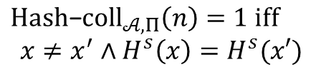


Collision Resistance
The Collision-Finding Experiment $Hash$-$coll_{𝒜,Π}(n)$:
$$s←Gen\left(1^{n}\right)$$
$$s$$
$$Challenger$$
$$Adversary 𝒜$$
$$x,x^{′}$$
$$Hash\text{−}coll_{𝒜,Π}\left(n\right)=1 iff$$
$$x≠x^{′}∧H^{s}\left(x\right)=H^{s}(x′)$$

Slide 9
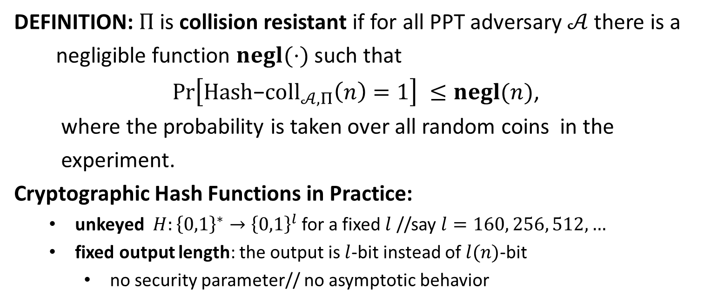
Collision Resistance
DEFINITION: $Π$is collision resistant if for all PPT adversary $𝒜$ there is a
negligible function $negl(⋅)$ such that
$\operatorname{Pr}\left[Hash\text{−}coll_{𝒜,Π}\left(n\right)=1\right] ≤negl(n)$,
where the probability is taken over all random coins in the
experiment.
Cryptographic Hash Functions in Practice:
unkeyed $H:{\left\{0,1\right\}}^{∗}→{\left\{0,1\right\}}^{l}$ for a fixed $l$ //say $l=160, 256, 512,…$
fixed output length: the output is $l$-bit instead of $l(n)$-bit
no security parameter// no asymptotic behavior

Slide 10



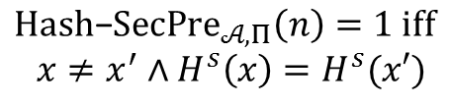
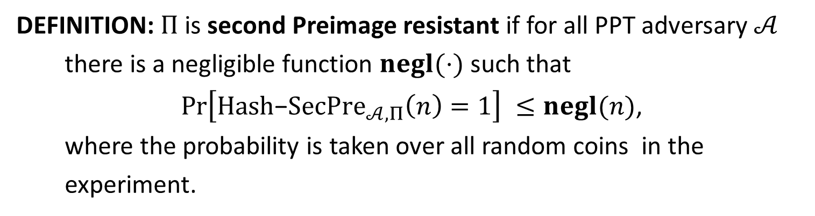


Second-Preimage Resistance
The Second Preimage-Finding Experiment $Hash$-$Sec{Pre}_{𝒜,Π}(n)$:
$$s←Gen\left(1^{n}\right)$$
$$x←{\left\{0,1\right\}}^{l^{′}(n)}$$
$$s,x$$
$$Challenger$$
$$Adversary 𝒜$$
$$x^{′}$$
$$Hash\text{−}SecPre_{𝒜,Π}\left(n\right)=1 iff$$
$$x≠x^{′}∧H^{s}\left(x\right)=H^{s}(x′)$$
DEFINITION: $Π$is second Preimage resistant if for all PPT adversary $𝒜$
there is a negligible function $negl(⋅)$ such that
$\operatorname{Pr}\left[Hash\text{−}SecPre_{𝒜,Π}\left(n\right)=1\right] ≤negl(n)$,
where the probability is taken over all random coins in the
experiment.

Slide 11



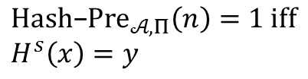
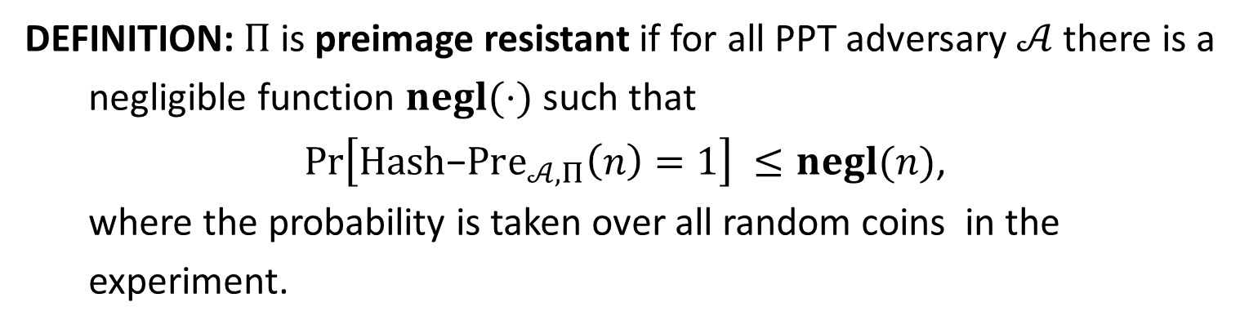
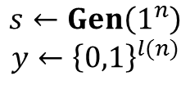

Preimage Resistance
The Preimage-Finding Experiment $Hash$-${Pre}_{𝒜,Π}(n)$:
$$s←Gen\left(1^{n}\right)$$
$$y←{\left\{0,1\right\}}^{l(n)}$$
$$s,y$$
$$Challenger$$
$$Adversary 𝒜$$
$$x$$
$$Hash\text{−}Pre_{𝒜,Π}\left(n\right)=1 iff$$
$$H^{s}\left(x\right)=y$$
DEFINITION: $Π$is preimage resistant if for all PPT adversary $𝒜$ there is a
negligible function $negl(⋅)$ such that
$\operatorname{Pr}\left[Hash\text{−}Pre_{𝒜,Π}\left(n\right)=1\right] ≤negl(n)$,
where the probability is taken over all random coins in the
experiment.

Slide 12
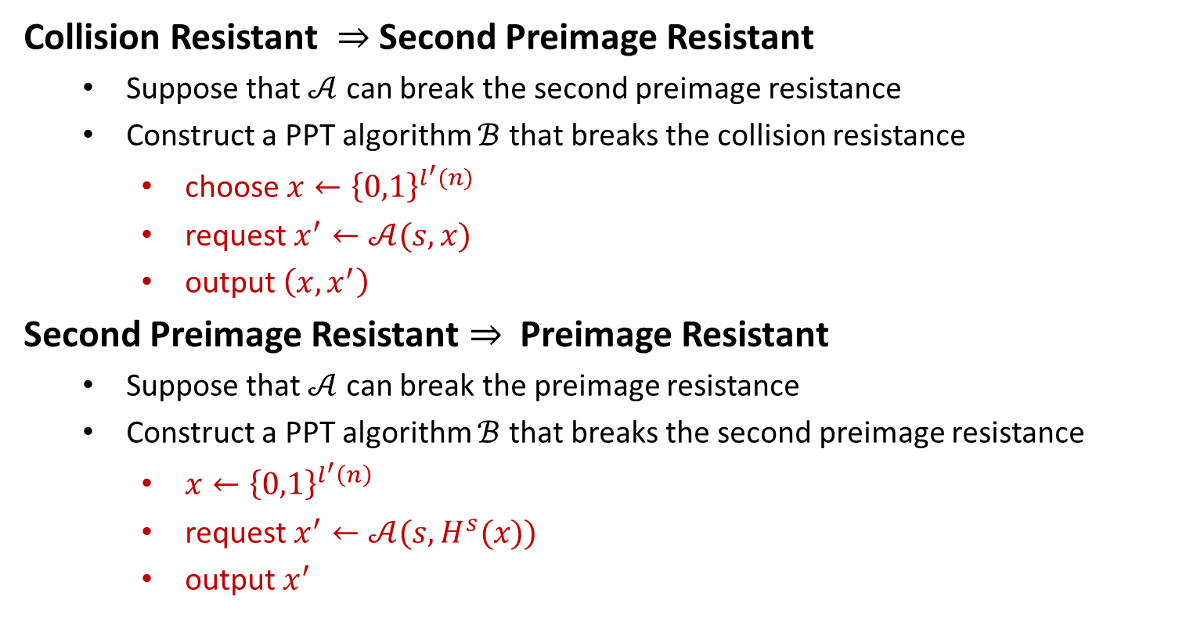
On the Security Levels
Collision Resistant $⇒$ Second Preimage Resistant
Suppose that $𝒜$ can break the second preimage resistance
Construct a PPT algorithm $ℬ$ that breaks the collision resistance
choose $x←{\left\{0,1\right\}}^{l^{′}(n)}$
request $x^{′}←𝒜(s,x)$
output $\left(x,x^{′}\right)$
Second Preimage Resistant $⇒$ Preimage Resistant
Suppose that $𝒜$ can break the preimage resistance
Construct a PPT algorithm $ℬ$ that breaks the second preimage resistance
$x←{\left\{0,1\right\}}^{l^{′}\left(n\right)}$
request $x^{′}←𝒜(s,H^{s}(x))$
output $x^{′}$

